Slide 1


Interactive Cyber Threat Visualization Dashboard
A real-time monitoring solution that transforms raw security data into actionable threat intelligence through dynamic visual analytics.

Slide 2
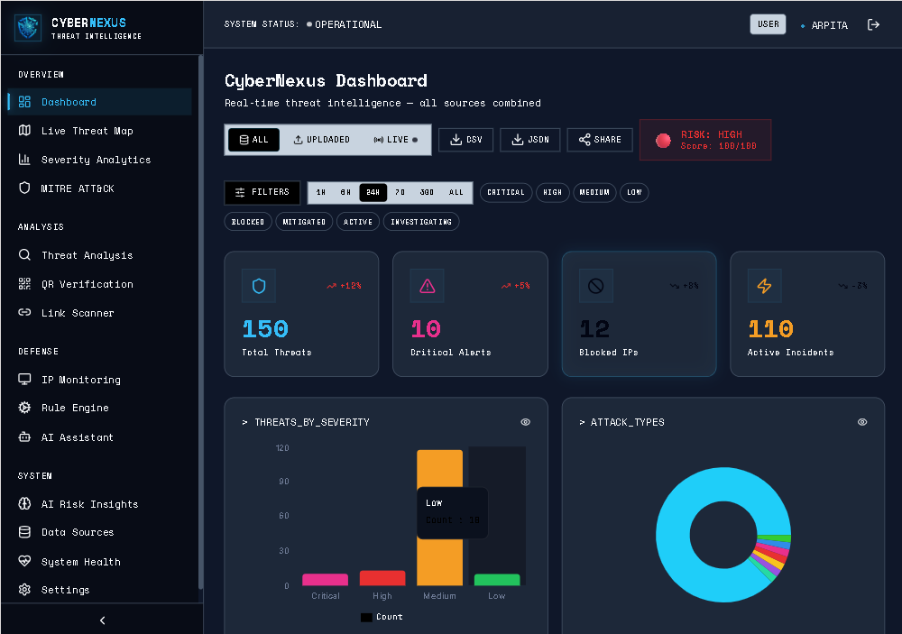
Why Visual Threat Intelligence Matters
Detect attacks instantly, not after damage is done.
See patterns clearly instead of reading complex logs.
Respond faster with real-time insights.
Reduce risk of data breaches and system downtime.

Slide 3





Four Core Capabilities
Geospatial Risk Mapping
Trend Detection
Instantly locate and visualise geographical origins and targets of cyber incidents on an interactive global map.
Identify recurring attack cycles, frequency spikes, and seasonal variations in threat activity using time-series analysis.
MITRE ATT&CK Alignment
Enhanced Reporting
Data-driven, executive-ready reports on current organisational risk profile for informed decision-making.
Map real-time security events to the MITRE ATT&CK framework to identify adversary tactics, techniques, and procedures (TTPs).

Slide 4
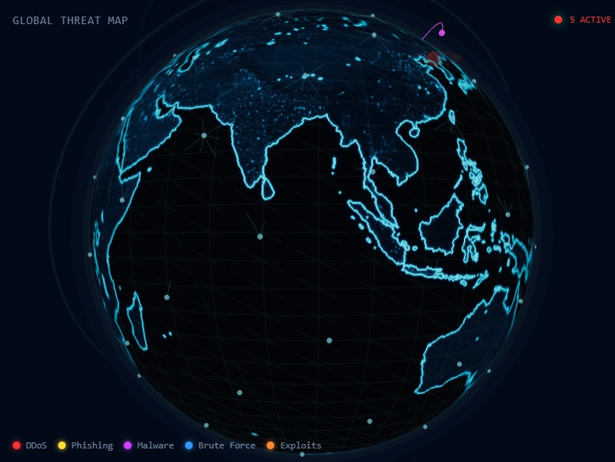
Geospatial Risk Mapping
Global Threat Visibility
01
02
Visualise cyber incidents across geographical boundaries, enabling analysts to identify regional attack patterns and source distributions.
Track real-time attack origins and target distributions to pinpoint regional hotspots and facilitate rapid, localized incident response.

Slide 5
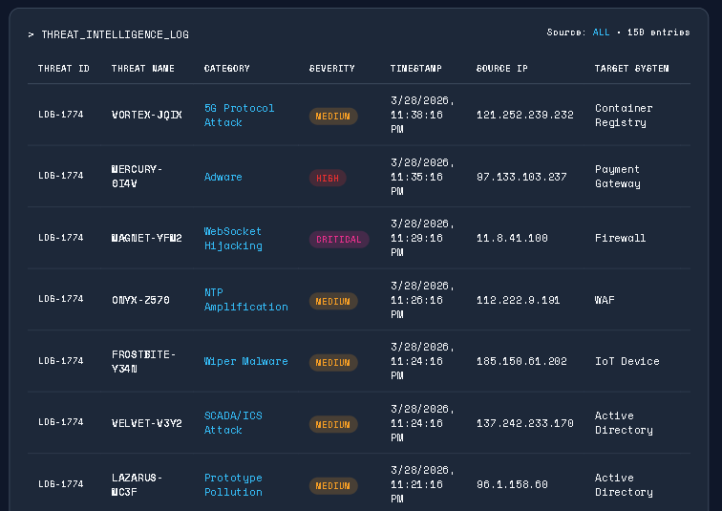
Strategic Vulnerability Prioritization
Leveraging Medallion Pipeline for Tactical Insights
Tactical Prioritization
Hierarchical charts and treemaps enable rapid identification of the most frequently targeted systems, services, and MITRE ATT&CK techniques.
Quick identification of most frequently targeted systems
MITRE ATT&CK technique mapping
Resource allocation optimisation

Slide 6
Trend and Anomaly Detection
01
02
03
Temporal Pattern Recognition
Frequency Spike Detection
Severity Assessment
Flag unusual increases in attack volume that may indicate coordinated campaigns.
Track changes in attack sophistication and exploit severity levels over time.
Identify recurring attack cycles and seasonal variations in threat activity.

Slide 7

System Architecture Overview
01
03
External Ingestion & Data Sources
Distributed Data Lake & Database
•OTX Threat Feed
•NVD & CVE Repository
•Network Discovery
•IP Reputation Database
•Telemetry Upload
Medallion Architecture: Bronze (Raw/Normalized) → Silver (Curated) → Gold (Actionable Insights) with RLS access control.
A four-layer architecture designed for scalability, security, and real-time threat intelligence processing.
02
04
Data Processing & Application Services
Presentation & Sentinel UI
•3D Visualization Globe
•Performance Dashboard
•TTP Matrix Navigator
•Human-AI Chatbot
•AI Forensics
•Authentication & RBAC
•SOAR Engine Automation
•WebSocket Controller

Slide 9
End-to-End Data Flow
Ingestion
Analysis
Storage
Visualization
1
2
3
4
OTX Feed & Nmap Scans
FastAPI & Gemini AI
Supabase (Bronze/Silver/Gold)
3D Globe & React Dashboard
Collect external threat data from multiple intelligence sources
AI & automation processing using FastAPI microservices
Medallion Data Lake structure with tiered refinement
Dashboards & UI insights for human interaction
Result: Faster threat detection and decision-making with actionable intelligence.

Slide 10
Four-Phase Development Roadmap
01
02
03
04
Data Acquisition & Structuring
Core Visualisation Development
Geospatial & Hierarchical Visualisation
Dashboard Integration & Finalisation
Collect and clean raw security incident data. Normalise fields to enable consistent analysis and mapping to MITRE ATT&CK categories.
Develop all time-series and categorical charts that quantify attack frequency, severity, and type distribution.
Implement interactive geographical map for risk mapping and treemap/sunburst chart for systemic vulnerability analysis.
Integrate all visualisations into single responsive Plotly/Dash application with interactive filtering capabilities.

Slide 11
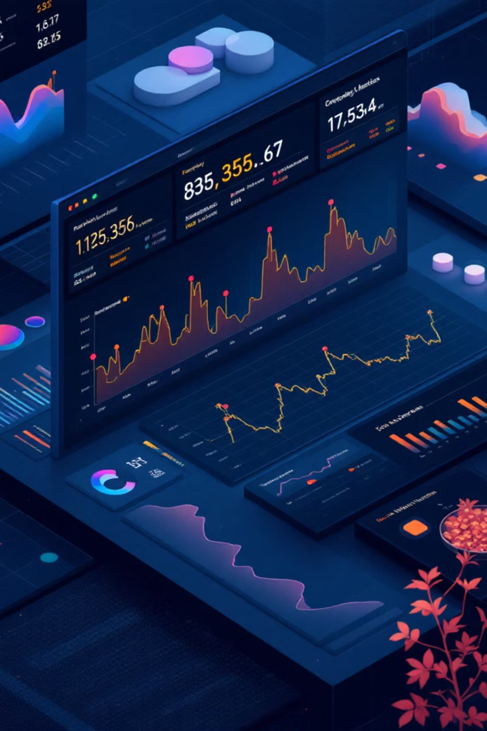
Key Technical Components
FastAPI Microservices
High-performance backend services for real-time data processing and WebSocket communication.
AI Forensics Engine
Machine learning models for automated threat pattern recognition and anomaly detection.
SOAR Automation
Security Orchestration, Automation, and Response for automated incident mitigation workflows.
3D Visualization Globe
Interactive geospatial mapping of threat origins and targets across global infrastructure.
TTP Matrix Navigator
MITRE ATT&CK framework integration for technique, tactic, and procedure classification.
Human-AI Chatbot
Natural language interface for querying threat intelligence and generating investigation reports.

